Slide 1
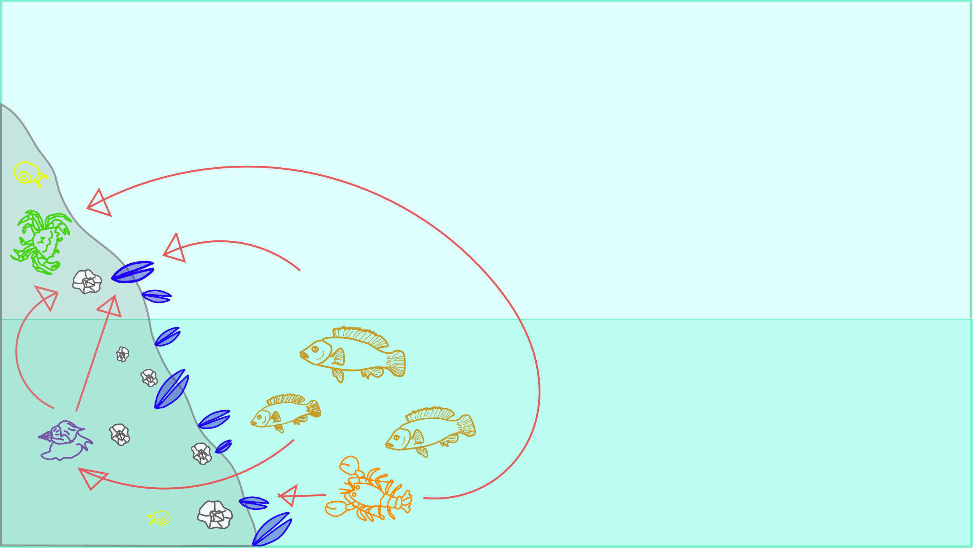
Structural equation modelling and ecological inference
Nicole Knight
QCBS R Symposium, 2022

Slide 2
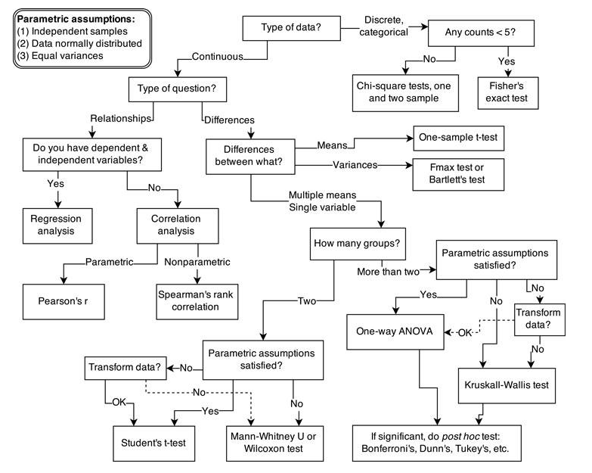
Undergraduate statistics training often looks something like this
McElreath et al. 2020

Slide 3

Undergraduate statistics training often looks something like this
McElreath et al. 2020

Slide 4

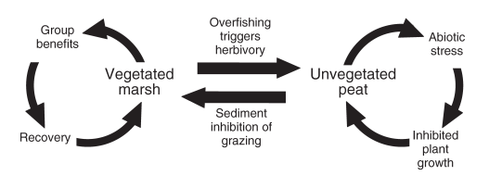
But ecology is complicated-
Altieri et al. 2012
Not all ecological concepts
are directly measurable
(e.g., biodiversity, ecosystem function)
Ecosystems are characterized
by direct and indirect effects

Slide 5

Ecologists need a pile of Legos, not a kit

Slide 6
Going from kits to loose Legos is the challenge

Slide 7
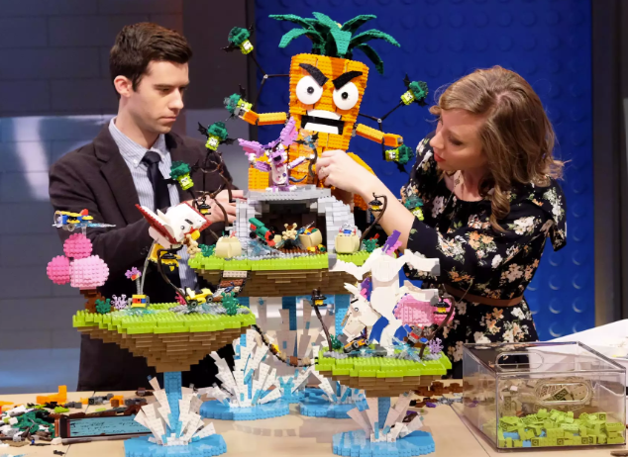
Going from kits to loose Legos is the challenge
RAY MICKSHAW/FOX

Slide 8
This is where structural equation models come in
RAY MICKSHAW/FOX

Slide 9
What is structural equation modelling?
Structural equation modelling is a framework for understanding relationships between multiple response variables

Slide 10
Why use structural equation models?
To model direct and indirect effects
To model theoretical concepts that can’t be measured directly (latent variables)
To do a better job of linking data to conceptual models

Slide 11
Why use structural equation models?
To model direct and indirect effects
To model theoretical concepts that can’t be measured directly (latent variables)
To do a better job of linking data to conceptual models

Slide 12
Why use structural equation models?
To model direct and indirect effects
To model theoretical concepts that can’t be measured directly (latent variables)
To do a better job of linking data to conceptual models

Slide 13
How do we build an SEM?

Slide 14
Steps to build a SEM
Step 1: Describe your system with causal diagrams
Step 2: Design your statistical model
Step 3: Code your model
Step 4: Check your model
Step 5: Interpret your model
Step 6: Present your model

Slide 15
What is a causal diagram?
A causal diagram is a conceptual model that describes cause-effect relationships in your system
They can be used for SEMs, designing experiments or observational work, building other types of models, etc.
Step 1: Describe your system

Slide 16
Anatomy of a
causal diagram
B
A
D
C
Path: effect or
relationship
Variable
Step 1: Describe your system

Slide 17
Anatomy of a
causal diagram
Response
and predictor
variable
B
A affects B
B affects D
Predictor variable
A affects D
A
D
Response
variable
A affects C
C
C affects D
Response
and predictor
variable
Step 1: Describe your system

Slide 18
Anatomy of a
causal diagram
B
A
D
Model equivalent
C
B ~ A
C ~ A
D ~ B + C + A
Step 1: Describe your system

Slide 19
What should go into my causal diagram?
Variables and paths that describe your core research questions/hypotheses
Potentially confounding variables (Step 4)
Variables and paths that describe reasonable alternative hypotheses/mechanisms
Step 1: Describe your system

Slide 20



Example: a simple food web
Traditional model
P
Estimated effects from this
model will NOT be “wrong”,
will just give net effect
R
P
positive effect
R
response
Step 1: Describe your system
negative effect
P
predictor

Slide 21
Example: a simple food web
Structural equation model
Building a model like this
will allow you to separate
direct and indirect effects
R, P
R
P
positive effect
R
response
Step 1: Describe your system
negative effect
P
predictor

Slide 22







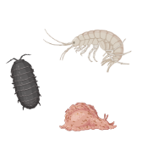
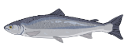
Exercise 1: Describe kelp ecosystems using dagitty
Epiphytes
Understory
algae
Kelp
Sea otters
Small
predators
Urchin
Large predators
Juvenile fish
Small grazers
Images from BioRender

Slide 23
Common pitfalls to avoid
Including paths between every single variable as a default
SEMs aren’t meant to be a fishing expedition
There is a data cost to every path you include (20 points/path ideal, 10/path good, 5/path absolute minimum)
Step 1: Describe your system

Slide 24
Common pitfalls to avoid
Including paths between every single variable as a default*
SEMs aren’t meant to be a fishing expedition
There is a data cost to every path you include (20 data points/path ideal, 10/path good, 5/path absolute minimum)
*You will eventually want to check that there
aren’t any obvious correlations in your data
that the model doesn’t account for
Step 1: Describe your system

Slide 25
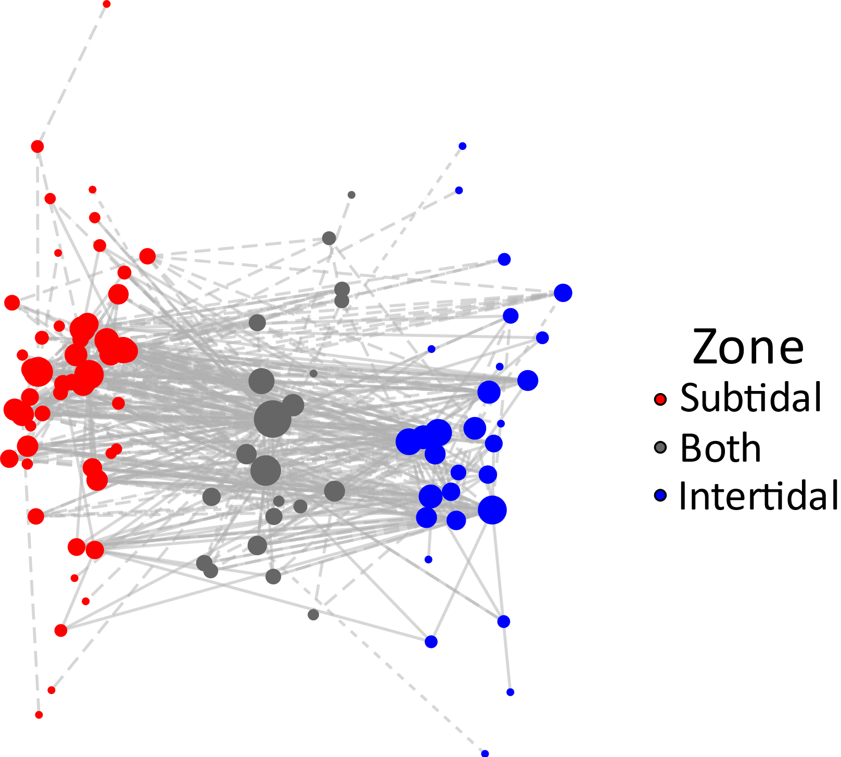
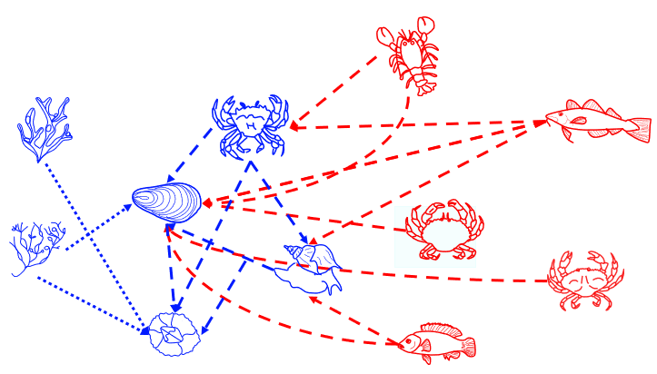
Common pitfalls to avoid
Including paths that are anticipated to be weak/unimportant
You can’t model everything
Knight et al. in prep
Burant, Peller, Beaulieu, Knight et al. in prep
Step 1: Describe your system

Slide 26
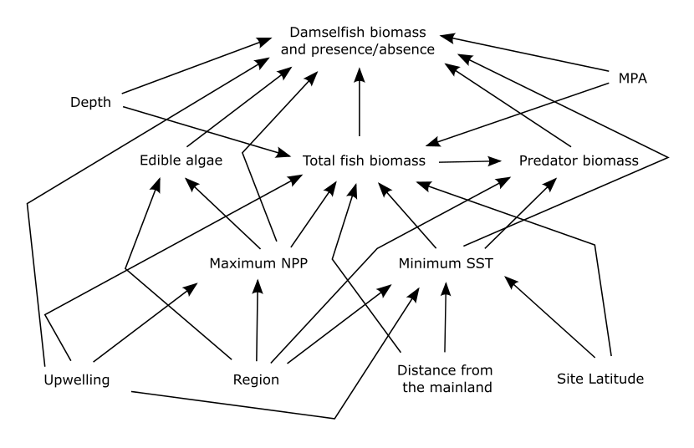
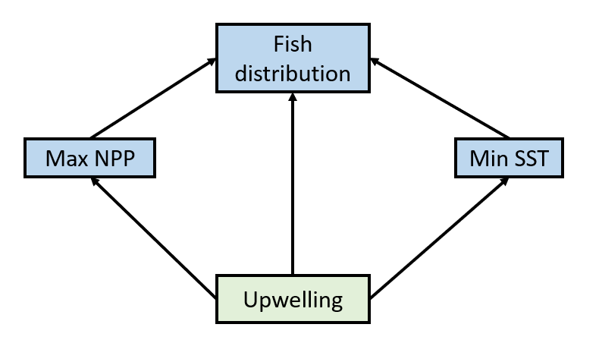
Common pitfalls to avoid
Trying to explain everything in your system
Focus on including paths that are relevant to your hypotheses
Step 1: Describe your system
Step 1: Describe your system

Slide 27
A few last tips
Document how and why you build your causal diagrams (preferably from Day 1)
R Markdown is a great tool for creating this documentation
Get external feedback on your causal diagram before moving forward
Step 1: Describe your system
Step 1: Describe your system

Slide 28
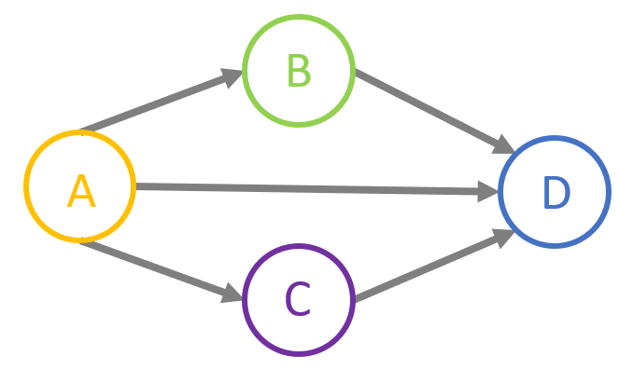
Design your statistical model
B ~ A
C ~ A
D ~ B + C + A
Step 2: Design your model

Slide 29
You know more than you think
The building blocks of SEMs are techniques you may already know
Linear models
Generalized linear models
Generalized additive models
Multilevel models
Bayesian models
Step 2: Design your model

Slide 30
Some considerations
Do I have data for all of my variables?
Do I have enough data? (5/path minimum)
Are my data spatial or temporal?
Are my data hierarchical?
What probability distributions best describe my response variables?
Do I have any latent or composite variables in my system?
Step 2: Design your model

Slide 31
Some considerations
Do I have data for all of my variables?
Do I have enough data? (5/path minimum)
Are my data spatial or temporal?
Are my data hierarchical?
What probability distributions best describe my response variables?
Do I have any latent or composite variables in my system?
Step 2: Design your model

Slide 32
Some considerations
Do I have data for all of my variables?
Do I have enough data? (5/path minimum)
Are my data spatial or temporal?
Are my data hierarchical?
What probability distributions best describe my response variables?
Do I have any latent or composite variables in my system?
Step 2: Design your model

Slide 33
Some considerations
Do I have data for all of my variables?
Do I have enough data? (5/path minimum)
Are my data spatial or temporal?
Are my data hierarchical?
What probability distributions best describe my response variables?
Do I have any latent or composite variables in my system?
Step 2: Design your model

Slide 34
Some considerations
Do I have data for all of my variables?
Do I have enough data? (5/path minimum)
Are my data spatial or temporal?
Are my data hierarchical?
What probability distributions best describe my response variables?
Do I have any latent or composite variables in my system?
Step 2: Design your model

Slide 35
Some considerations
Do I have data for all of my variables?
Do I have enough data? (5/path minimum)
Are my data spatial or temporal?
Are my data hierarchical?
What probability distributions best describe my response variables?
Do I have any latent or composite variables in my system?
Step 2: Design your model

Slide 36
Some considerations
Do I have data for all of my variables?
Do I have enough data? (5/path minimum)
Are my data spatial or temporal?
Are my data hierarchical?
What probability distributions best describe my response variables?
Do I have any latent or composite variables in my system?
Step 2: Design your model

Slide 37
What type of SEM should I build?
All of my response variables are normally distributed and non-hierarchical because I’m the luckiest person in the world
Traditional variance-covariance SEM
Step 2: Design your model

Slide 38
What type of SEM should I build?
All of my response variables are normally distributed and non-hierarchical because I’m the luckiest person in the world
Traditional variance-covariance SEM
At least one of my response variables is not normally distributed or I have hierarchical data
Piecewise SEM
Step 2: Design your model

Slide 39
What type of SEM should I build?
All of my response variables are normally distributed and non-hierarchical because I’m the luckiest person in the world
Traditional variance-covariance SEM
At least one of my response variables is not normally distributed or I have hierarchical data
Piecewise SEM
Step 2: Design your model

Slide 40
What R package should I use?
lavaan
Frequentist package specific to SEMs
Can accommodate latent, composite variables
Designed for “traditional” SEMs
Step 3: Code your model
Step 2: Design your model

Slide 41
What R package should I use?
lavaan
Frequentist package specific to SEMs
Can accommodate latent, composite variables
Designed for “traditional” SEMs
piecewiseSEM
Frequentist package specific to SEMs
Can’t accommodate latent, composite variables
Model structure must be acyclic
Designed for non-normal data, hierarchical data
Step 3: Code your model
Step 2: Design your model

Slide 42
What R package should I use?
lavaan
Frequentist package specific to SEMs
Can accommodate latent, composite variables
Designed for “traditional” SEMs
piecewiseSEM
Frequentist package specific to SEMs
Can’t accommodate latent, composite variables
Model structure must be acyclic
Designed for non-normal data, hierarchical data
brms
General Bayesian modelling package
Cannot easily code latent or composite variables
Model structure must be acyclic
Otherwise extremely flexible
Allows for tools like posterior predictive checks
Can be slow to run
Step 3: Code your model
Step 2: Design your model

Slide 43
Latent variables
Latent variables cannot be observed,
but can be represented by indicator variables
Step 2: Design your model

Slide 44
Latent variables
Latent variables cannot be observed,
but can be represented by indicator variables
Examples of latent variables:
body size
biodiversity
habitat quality
ecosystem function
ecosystem recovery
Step 2: Design your model

Slide 45
Latent variable
Indicator variables
body size
body mass, length, height
species richness, species evenness,
phylogenetic diversity
biodiversity
habitat quality (seagrass)
shoot density, blade length,
patch size
Step 2: Design your model

Slide 46


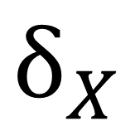
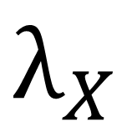
Modelling a latent variable
effect of latent
variable on indicator
$$λ_{X}$$
error
$$ξ$$
$$δ_{X}$$
$$X$$
indicator
variable
latent variable
Step 2: Design your model

Slide 47
Modelling a latent variable
latent variables can be
modelled using the
lavaan package
effect of latent
variable on indicator
$$λ_{X}$$
error
$$ξ$$
$$δ_{X}$$
$$X$$
indicator
variable
latent variable
Step 2: Design your model

Slide 48
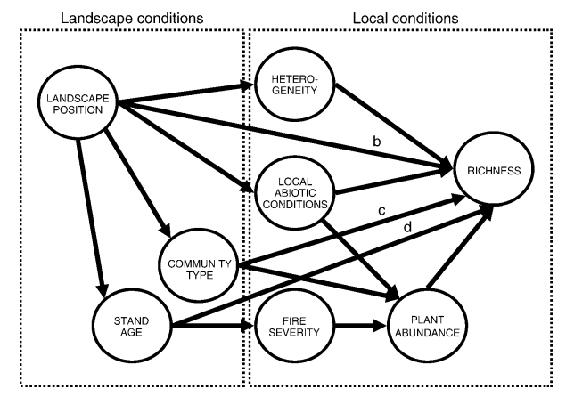
Exercise 2: Coding a classic SEM using piecewiseSEM
How do wildfires affect plant diversity across a landscape?
Grace, J. B., & Keeley, J. E. (2006). A structural equation model analysis of postfire plant diversity in California shrublands. Ecological Applications: A Publication of the Ecological Society of America, 16(2), 503–514.
Step 3: Code your model

Slide 49
Checking your model fit
Check model fit
Check that your path coefficients make sense!
Step 4: Check your model

Slide 50
Check model fit: Tests of directed separation
Tests whether we are missing any paths
Fits missing relationships and tests whether path coefficients are significantly different from 0
If any values p < 0.05, need to re-evaluate model
Step 4: Check your model

Slide 51
What if your model fits, but it doesn’t make sense?

Slide 52

Example: intertidal competition
System:
Barnacles recruit in early spring
Mussels recruit after barnacles, but are better competitors for space
Both species decrease in abundance moving from the low -> high intertidal
We collect abundance data over a 10 year period
Step 4: Check your model

Slide 53

Example: intertidal competition
System:
Barnacles recruit in early spring
Mussels recruit after barnacles, but are better competitors for space
negative effect
Step 4: Check your model
positive effect

Slide 54
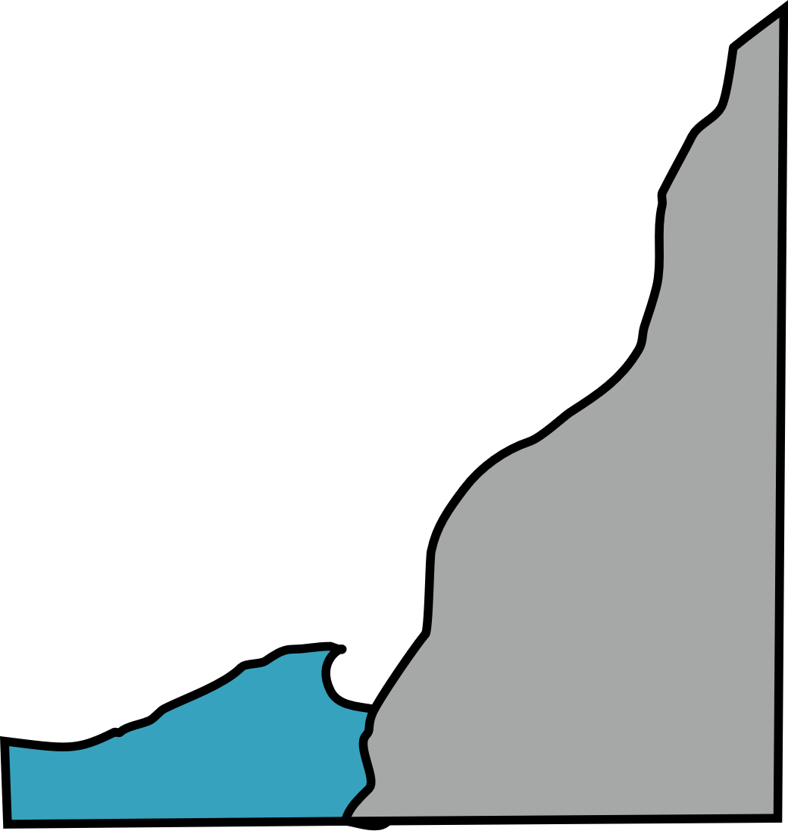
Example: intertidal competition
System:
Barnacles recruit in early spring
Mussels recruit after barnacles, but are better competitors for space
Both species decrease in abundance moving from the low -> high intertidal
We collect abundance data over a 10 year period
intertidal
position
negative effect
Step 4: Check your model
positive effect

Slide 55
Example: intertidal competition
System:
Barnacles recruit in early spring
Mussels recruit after barnacles, but are better competitors for space
Both species decrease in abundance moving from the low -> high intertidal
We collect abundance data over a 10 year period
intertidal
position
negative effect
Step 4: Check your model
positive effect

Slide 56
Confounding variables
An unmeasured variable influencing both a predictor and a response variable
Step 4: Check your model

Slide 57
Sometimes you get the opposite effect estimate that you hypothesized
Original causal diagram
Effect estimates
intertidal
position
intertidal
position
negative effect
positive effect

Slide 58
Confounding variables, a phantom menace
???
intertidal
position
negative effect
positive effect

Slide 59



Confounding variables might be a shared predictor
Wave exposure
A shared predator
intertidal
position
Thermal stress
negative effect
positive effect

Slide 60
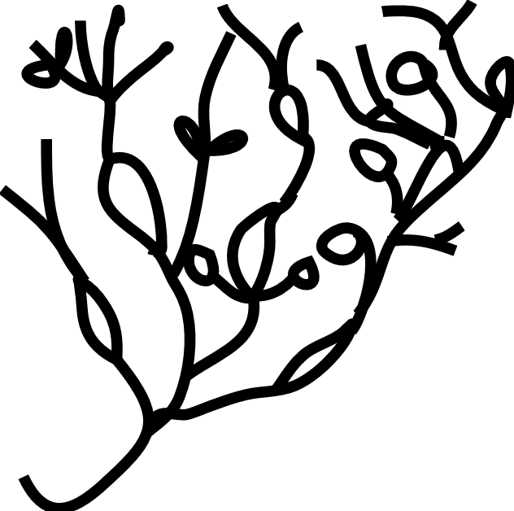
Confounding variables might be a mediator
An algae that
facilitates predators
intertidal
position
negative effect
positive effect

Slide 61
Even if a confounding variable doesn’t
change the sign of a path/effect,
the strength of the effect might
change (and this is harder to detect)

Slide 62



Exercise 5: A simple intertidal food web in brms
What is the effect
of cod predation
on intertidal communities?
Step 5: Interpret your model

Slide 63
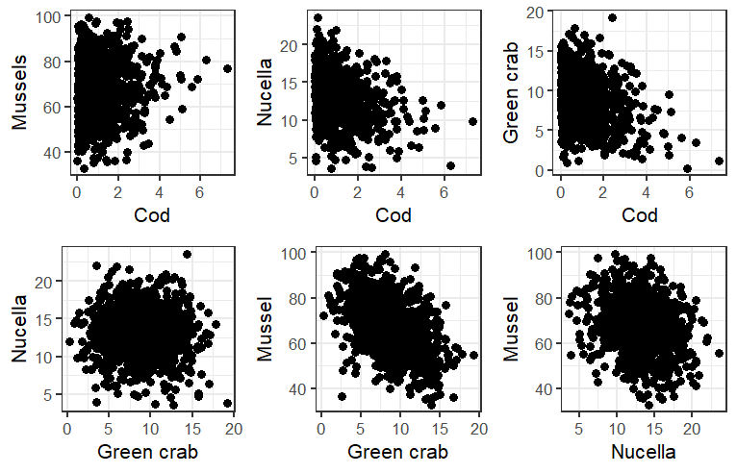
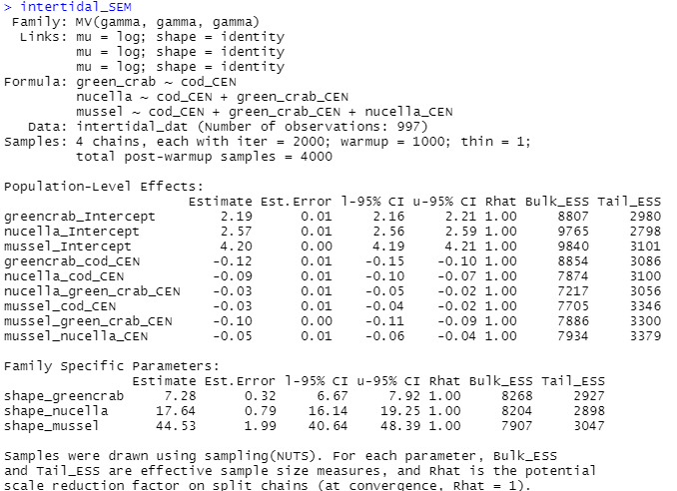
Exercise 5: A simple intertidal food web in brms
Built SEM in brms using fake data
fake_intertidal_data.csv
intertidal_SEM.rds
Step 5: Interpret your model

Slide 64


Exercise 5: A simple intertidal food web in brms
A
Net effect of cunner on mussels
= A + (B * C)
C
direct effect
indirect effect
B
Step 5: Interpret your model

Slide 65
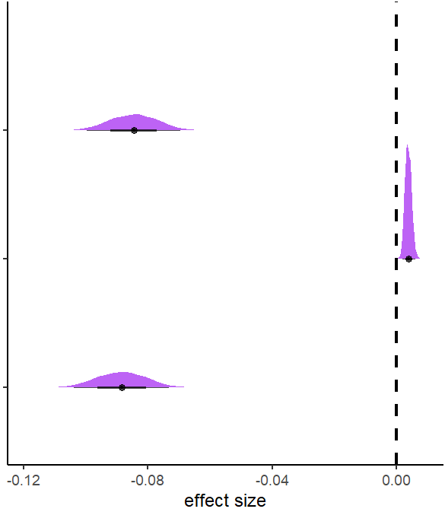
Exercise 5: A simple intertidal food web in brms
Step 5: Interpret your model

Slide 66

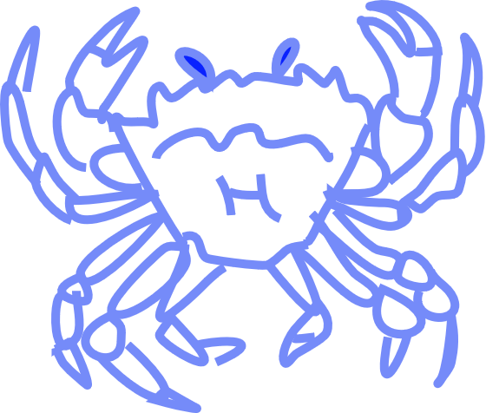
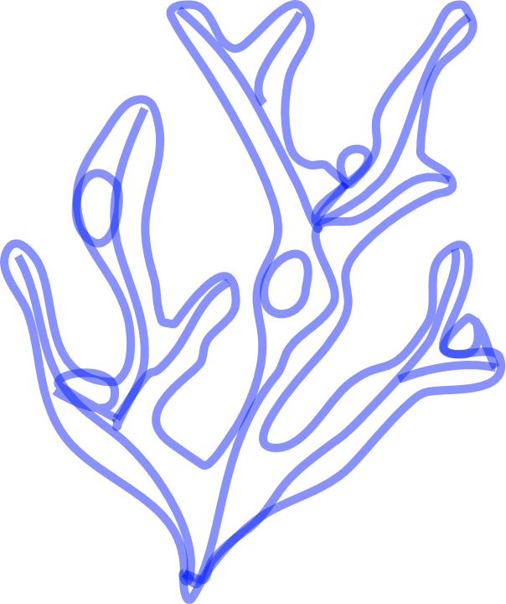

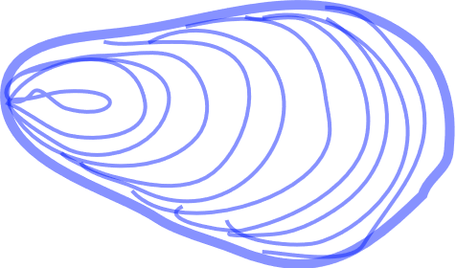
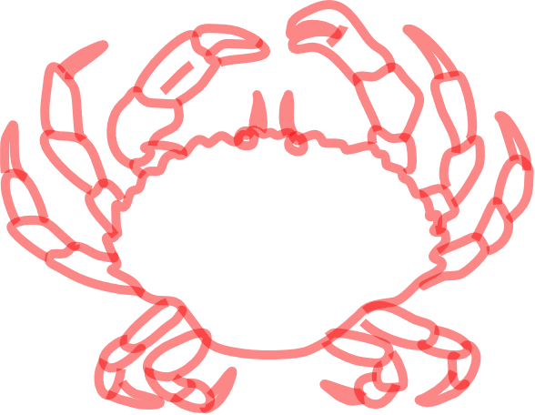
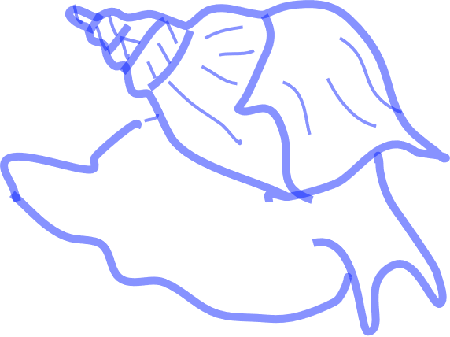
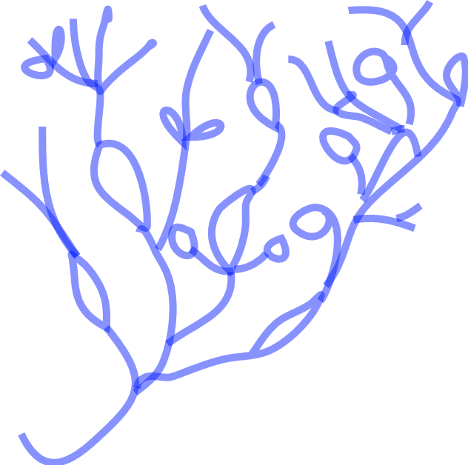



Presenting your model

Slide 67
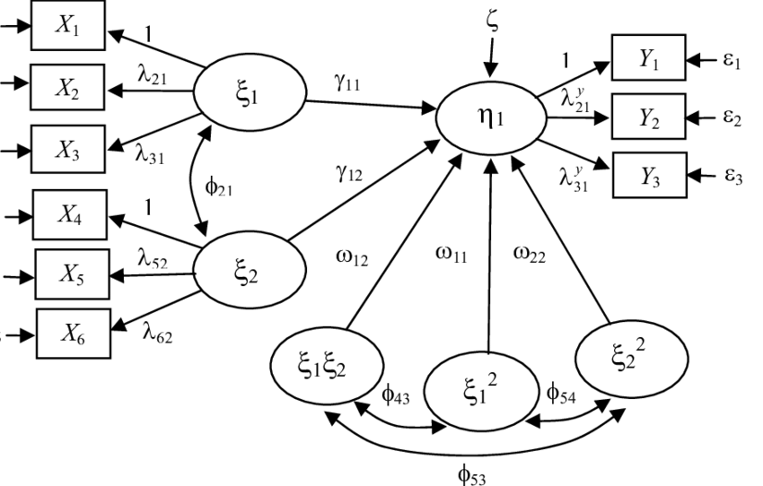
What not to do
Throw something like
this up on the
screen and start talking
Step 6: Present your model

Slide 68
What to do
Explain what a SEM is
Explain how your SEM tests your research questions
Build up your SEM slowly and explain the important paths
Consider not showing control variables/unimportant variables
If you put up coefficients, explain units
Take your time!
Step 6: Present your model

Slide 69
What to do
Explain what a SEM is
Explain how your SEM tests your research questions
Build up your SEM slowly and explain the important paths
Consider not showing control variables/unimportant variables
If you put up coefficients, explain units
Take your time!
Step 6: Present your model

Slide 70
What to do
Explain what a SEM is
Explain how your SEM tests your research questions
Build up your SEM slowly and explain the important paths
Consider not showing control variables/unimportant variables
If you put up coefficients, explain units
Take your time!
Step 6: Present your model

Slide 71
What to do
Explain what a SEM is
Explain how your SEM tests your research questions
Build up your SEM slowly and explain the important paths
Consider not showing control variables/unimportant variables
If you put up coefficients, explain units
Take your time!
Step 6: Present your model

Slide 72
What to do
Explain what a SEM is
Explain how your SEM tests your research questions
Build up your SEM slowly and explain the important paths
Consider not showing control variables/unimportant variables
If you put up coefficients, explain units
Take your time!
Step 6: Present your model

Slide 73
What to do
Explain what a SEM is
Explain how your SEM tests your research questions
Build up your SEM slowly and explain the important paths
Consider not showing control variables/unimportant variables
If you put up coefficients, explain units
Take your time!
Step 6: Present your model

Slide 74
Thank you for listening!
If you have questions, feel free to contact me
nicole.knight@mail.mcgill.ca

